Slide 1
Dev Ops

Slide 2
DevOps
Software Development (dev) Operations (ops) are a set of practices and methodologies designed to combine the development (production/writing of code), deployment and maintenance of code into a streamlined process.
The primary goal of DevOps is to expedite the lifecycle of application development, particularly through the automation of tasks.

Slide 3
Steps in Dev Ops and Production of Code
The steps or phases for Dev Ops refers to the creation, testing, and deployment of an application.
Source code Control: Producing (writing) code and pushing to a repository
Building and Testing Automation: Test basic functionality of code (Generally unit testing) and create a new, working build
Deploying to Staging: Deployment of working build to a temporary environment
Acceptance Testing: Undergo other more complex tests (systems, integration) within temporary environment
Deployment of Build: Migrate working build to Production environment accessible by end users

Slide 4
DevOps and Agile
Agile is a mentality or philosophy utilized when approaching the creation of information systems and is a flexible approach of addressing the steps of the Software Development Life Cycle.
Development teams who practice an Agile methodology place a focus on producing code through iteration and collaboration rather than following a rigid plan.

Slide 5
DevOps and Agile
Though DevOps, which involves the creation of a systematic approach to producing code, and Agile, which is a mentality that focuses on creating products by adapting to change quickly, seem contradictory, the goal of both methodologies is to produce working and valuable product more efficiently.
DevOps pertains to the entire system working together to produce, test, deploy and maintain the code base, while Agile practices allow for each step of that process to change wherever and whenever needed.

Slide 6
DevOps and Agile
Agile Practices with DevOps:
Continuous Integration
Continuous Delivery
Continuous Deployment

Slide 7
DevOps and Agile
Adoption of the Agile philosophies can provide a steppingstone for the establishment of a working DevOps pipeline, as Agile practices intrinsically produce more continuous feedback loops.
Continuous Integration, Continuous Delivery and Continuous Deployment seek to automate the phases of DevOps as much as possible.

Slide 8
DevOps - Continuous Integration

Slide 9
Continuous Integration
Continuous Integration (CI) is the first, and most fundamental step in creating an autonomous development pipeline.
Similarly, to Continuous Delivery and Continuous Deployment, Continuous Integration is a development team mentality, and is achieved when all members of the development team practice consistent merging of code into a central repository.
For CI to take place, these Central repositories should be in the form of version control software.

Slide 10
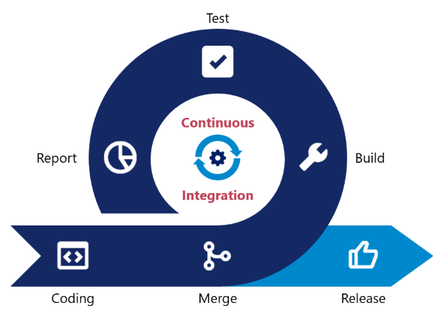
Continuous Integration
Version control software is a tool which utilizes some directory structure to store files.
These tools can track changes to code, and allow for changes to be merged (allowing you to select which changes to keep or reject if/when conflicts arise) or files to be rolled back to a previous version.
The integration of code into these repositories should happen as often as possible with at least one commit each day.
Generally, the more frequently code is merged, the less conflicts and/or integration issues will arise.

Slide 11
Continuous Integration - Benefits
Ensures the entire team works on the most up to date code
Frequently pushing code allows developers to account for changes performed by other team members quickly.
Detects broken builds quickly
If problems arise, version control software can help detect the root cause or rollback changes when necessary.
Code can be tested easily by creating separate, test or development branches based on the mainline code.
Reduces risk in development when a large codebase has already been established.
Reduces the overall number of bugs in a project

Slide 12
DevOps - Continuous Delivery

Slide 13
Continuous Delivery
Continuous Delivery is a paradigm in which the building, management and testing of produced software is automated such that deployments can be performed at the push of a button.

Slide 14
Continuous Delivery
Continuous delivery is often confused with Continuous Deployment, which automates the entire production pipeline, including deployment.
Continuous Delivery; however, is the process of automating all steps of a Development pipeline except for the final deployment step.
Inherently, Continuous Delivery is dependent on the implementation of Continuous Integration, and also serves as a stepping stone to creating a fully automated Development Pipeline (Continuous Deployment).

Slide 15
Continuous Delivery
Though Continuous Integration can technically be achieved without automation, Continuous Delivery is only achieved when code integration, testing and product building has been automated.
In this way, you are able to perform frequent deployments "at the press of a button", but may choose not to do so, usually for business purposes or possibly due to a preference for a regular scheduled deployment process.

Slide 16
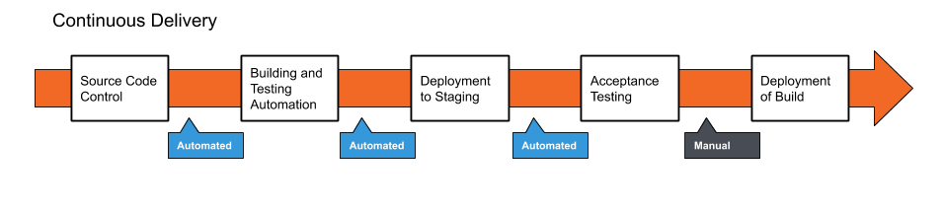
Continuous Delivery
The deployment to production may also be kept manual so that final user acceptance tests can be performed manually as a final safety check on the code to ensure that it meets business needs.
This is due to the difficulty and cost of creating tests to evaluate the user experience and not simply the functionality.

Slide 17
Continuous Delivery - Benefits
Reduced Risk in Deployment
Since new builds are not deployed automatically, faulty code is less likely to by deployed to production environments.
Less pressure is placed on the development team by allowing for small, more frequent changes to be made. This expedites the iteration of code.
Predictable Progress
Since pipelines are a programmable infrastructure by the development team, desired behavior during the production of code is easier to configure.
With a pipeline the deployment process is more predictable, allowing development team to focus on the production of code rather than operational steps required to deploy the new codebase.
Frequent Feedback
With the increased efficiency of producing code, smaller, more incremental changes can be applied to a system more frequently. If human error does cause problems, it is easy to roll back changes to a working build.
More releases accelerates the communication and feedback loop with client/product owners as well.

Slide 18
Costs/Considerations of Continuous Delivery
Requires a strong foundtation with Continuous Integration culture, and test suite coverage
The Final deployment must still be automated which is an additional cost, Though the trigger to begin the process is manual this can still cause slowdown for the development.
Communication of incomplete features and backlog must be maintained rigorously to communicate expectations to client and development team

Slide 19
DevOps - Continuous Deployment

Slide 20
Continuous Deployment
Continuous Deployment is a process of releasing software in which changes are tested for stability and correctness automatically.
This results in immediate, autonomous deployment of code to production environments.

Slide 21
Continuous Deployment
Continuous Deployment is often confused with Continuous Delivery due to nomenclature as both are referred to as 'CD'; however, Continuous Delivery is simply a precursor to Continuous Deployment.
In Continuous Delivery there is a final, manual approval process needed before code is deployed to production environments.
Continuous Deployment forgoes human intervention at every step of the deployment process and pushes new code into the working production environment immediately so long as it meets the test requirements.
When Continuous Deployment is achieved, every committed change to the code base creates and deploys a new build to the production environment.

Slide 22
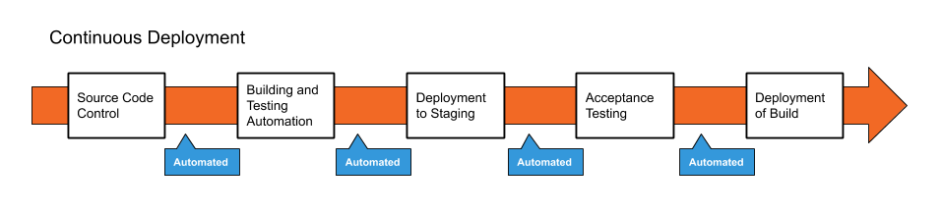
Continuous Deployment
Continuous Deployment is the ultimate goal for establishing a true DevOps pipeline, as it ensures that all steps for the creation of product, including code creation, testing, building, and deployment are automated and work seamlessly together.

Slide 23
Benefits of Continuous Deployment
Even faster development process, without the need to pause for deployment.
New releases are less risky, as small changes can be easily recognized and fixed, allowing for better and quicker feedback.
Increased communication and regular streams of improvements are generally regarded highly by customers.

Slide 24
Costs/Risks of Continuous Deployment
Establishing a Continuous Deployment pipeline requires a more substantial investment in the engineering, and the testing culture.
Documentation of processes is required to communicate to development, production and testing teams.
Ongoing maintenance of deployment pipeline is required to ensure work continues running smoothly, increasing production costs.
Feature flags (communication of completed features and progress) are required for coordination between departments.

Slide 25
DevOps and Agile

Slide 26
DevOps and Agile
As the development and deployment of applications became increasingly important, DevOps and Agile have increased in popularity as methods to optimize the process of software production.
DevOps originally sought to reduce the number of manual steps necessary to produce software, resulting in more streamlined and faster releases.
Agile practices encourage collaboration and re-evaluation of systems in favor of improvements.

Slide 27
DevOps and Agile
Both methodologies underlyingly serve the same purpose:
To create working and valuable code as quickly and efficiently as possible.
DevOps inherently adopts many Agile methodologies, as it encourages the collaboration of development and operations when creating software products.

Slide 28
DevOps and Agile
Generally, there are three ways of approaching DevOps culture.
System Thinking: Placing emphasis on the performance of an entire system.
Amplify Feedback Loops: Through the use of automation, the speed and efficiency of feedback loops can drastically improve.
Culture of Continual Experimentation and Learning: Fostering a work culture which values taking risks, learning from failure, and understanding that practice and repetition are the prerequisites to mastery, leads to increased collaboration and self-reflection. This promotes further improvement for an entire workplace community, and is even reflected through Agile retrospective meetings.

Slide 29
DevOps Tools - Sonar

Slide 30
Sonar
Sonar cloud, Sonar Qube and Sonar lint are code quality analysis tools which increase the readability, security and matainability of code.
Utilizing code quality analysis tools can help development teams produce higher quality code, and provide standardization between developers, which can play a vital role in the integration of code.

Slide 31
Code Quality Analysis and Code Smells
Code Quality Analysis tools are programs specifically designed to expose errors as well as 'code smells'.
Code Smells
Vulnerabilities
Data security issues
Bugs
Issues with functionality of code
Maintainability issues
Confusing or hard to maintain code
Repeated instances of code
Unused imports
Empty code blocks
Unaddressed automated code comments

Slide 32
Sonar Cloud
A cloud based code review solution which can be configured to review code within a cloud repositoy, such as Github.

Slide 33
Sonar Qube
Code review tool built to work on a centralized server or integrated into a development pipeline.
Due to the increased flexibility and configuration options of Sonar Qube, it can be seen as a more powerful tool.

Slide 34
Sonar Lint
Sonar Lint is a free, open-source linting tool.
A linting tool/linter is a software tool which, when integrated with an IDE, can provide increased feedback to the developer.
Traditional IDE tools utilize built-in linters to identify code syntax errors, and exceptions.
Sonar Lint provides further suggestions by recognizing code smells.

